Slide 1
Session 9
Chapter 4 – High-level Database Models ER model
Database Systems

Slide 2
Objectives
1
Understand the Database Design Process
2
Understand what is the high-level design (or Conceptual Design)
3
Understand why must use Conceptual Design (or Logical Design)
4
Understand the purpose of a ERD
5
Know what are Entity, Entity Set, Entity Instances, Attributes and others
6
Know what is a relationship and how to realize it
7
Know how to draw an ERD

Slide 3
Contents
1
Database design process
2
Entity relationship model
3
What are entity, entity set, attribute, relationship?
4
ERD
5
Attributes on Relationships
6
Weak Entities
7
Sub-class

Slide 4
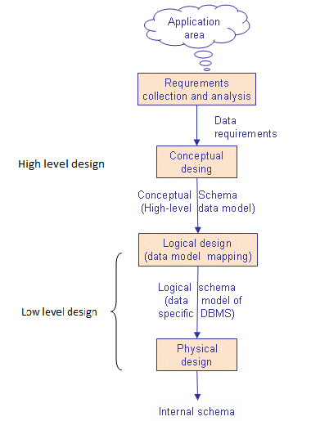
Database Design Process

Slide 5
The Requirements Problem
In the USA, a study found that 31% of all software projects were canceled before completion
Further results were that 53% of projects cost an average of 189% of their original estimates
$81B for canceled projects; additional $59B for projects that exceeded their original estimates

Slide 6
The Requirements Problem
The first step to resolving any problem is to identify the root cause
The same study identified the following root causes:
  Lack of user input
  Incomplete requirements and specifications
  Changing requirements and specifications

Slide 7
The Requirements Problem
Even though the majority of projects experienced time overruns, if not outright cancellation, successful projects had the following “success factors”:
  User involvement
  Executive management support
  Clear statement of requirements

Slide 8
The Requirements Problem
The problems associated with “leakage” from requirements phase:
  Respecification
  Redesign
  Recoding
  Retesting
  Corrective action – recall, scrap, liability, service calls, documentation changes

Slide 9
The Requirements Problem
0.1
Requirements
0.5
Design
1
Coding
2
Unit Testing
5
Acceptance Testing
20
Maintenance
Relative Cost To Repair Defect

Slide 10
High-level design
Now, we have know the important role of getting user requirements
So, how to express User Requirements exactly, correctly and easily when designing database? The solution is: we must do the high-level design step first because it is the bridge between the Customer and Programmer.
It helps us to exchange ideas with the customer and understand what their needs

Slide 11
High-level design
High-level design describes exactly the information needs of the business
It facilitates the discussions
It helps to prevent mistakes, misunderstanding
It forms the important “idea system” document

Slide 12
How to express High-Level Design
The high-level design could be expressed by:
  “Entity Relationship Diagram”
  UML (“Unified Modeling Language”)
We don’t focus on UML in our lessons now but ERD

Slide 13
Low-level design
Logical design is process of constructing a model of information used in an enterprise based on a specific data model, but independent of a particular DBMS or other physical considerations
Physical design is process translating the logical description of the data into technical specifications for storing and retrieving data

Slide 14
4.1 Entity-Relationship Model
Entity Relationship Model (E/R model) represents graphically the structure of data as an “Entity-Relationship Diagram” (ERD) using 3-principal types of elements:
1. Entity Sets
2. Attributes
3. Relationships

Slide 15
4.1.1. Entity and Entity sets
An Entity is:
  an object in the real world that is distinguishable from other objects
  “Something” important to the business about which data must be known
An Entity set is:
  A collection of similar entities
Example:
  Each movie is an entity;
  And the set of all movies is called Movie Entity Set

Slide 16
Entity and Entity sets
Entities | Entity sets
“Gone with the wind”, “Stars war”, “Mission impossible”, … | MOVIES
Tom Cruise, Vivien Leigh, Scarlett Johansson | STARS
Warner Bros, Paramount pictures, 20th Century Fox | STUDIOS

Slide 17
How to realize Entities?
Entities are usually NOUNs
Entities can be:
- Tangible (exp: HOUSE, CAR..)
- In-Tangible (exp: LOVE, RING-TONE…)
- Events (exp: ELECTION)
Generalize NOUNs that are similar.
Exp:
+ TOYOTA, MITSUBISHI, HUYNDAI can be generalized to “Car-maker”
+ HONDA, SYM, YAMAHA can be generalized to “Motor-maker”
+ Nokia, Samsung, Motorola can be generalized to what?
+ David Beckham, Ronaldo, Ronaldinho can be generalized to what?
+ ZIXEL, ZOOM, LINK SYS can be generalized to what?
+ Think pad IBM, FPT Elead, Compact HP can be genralized to what ?

Slide 18
4.1.2. Attributes
An Entity is described using a set of attributes which are important to the business
  An attribute is a property of the Entity or a small detail about the entity
All entities in a given entity set have the same attributes
Example: Movies set has attributes “Title”, “length”, “year” and “genre”
An attribute has values. All values for a particular attribute have the same data type.
Some attributes are volatile (unstable). Example: AGE. So, we must always look for non-volatile attributes (exp: we can replace AGE by DATE-OF-BIRTHDAY)

Slide 19
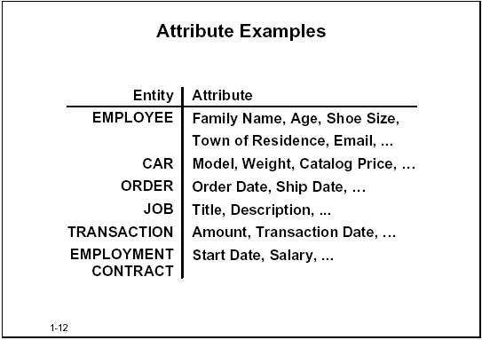
Example: Attributes

Slide 20
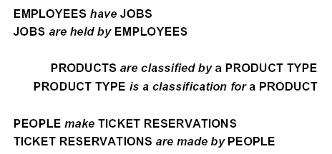
4.1.3 Relationships
Relationships are connections among two or more entity sets
Example:
  Relationship Stars-in that connects Movies and Stars entity sets
Relationships are usually Verbs
Example:

Slide 21
How to realize relationship?
To determine a relation-ship we ask questions like this:
+ “Must every employee has a job?”
+ “Must every job be done by an employee?”
Other questions:
+ Can a employee have more than 1 job?
+ Can a job can be done by more than 1 employee?

Slide 22
Types of relationship?
Cardinality: describes the maximum number of possible relationship occurrences for an entity participating in a given relationship type
  MANY-MANY relationship
  ONE-MANY relationship
  ONE-ONE relationship
Participation: determines whether all entity occurrences are involved in a particular relationship or only some
  Mandatory
  Optional

Slide 23
4.1.4 Entity-Relationship Diagrams
How to represent Entity Sets and Attributes
In an Entity-Relationship diagram:
  Entity set = rectangle.
  Attribute = oval
  Edges connect an entity set to its attributes
  Key attribute(s) are underlined
title
year
Movies
length
genre

Slide 24
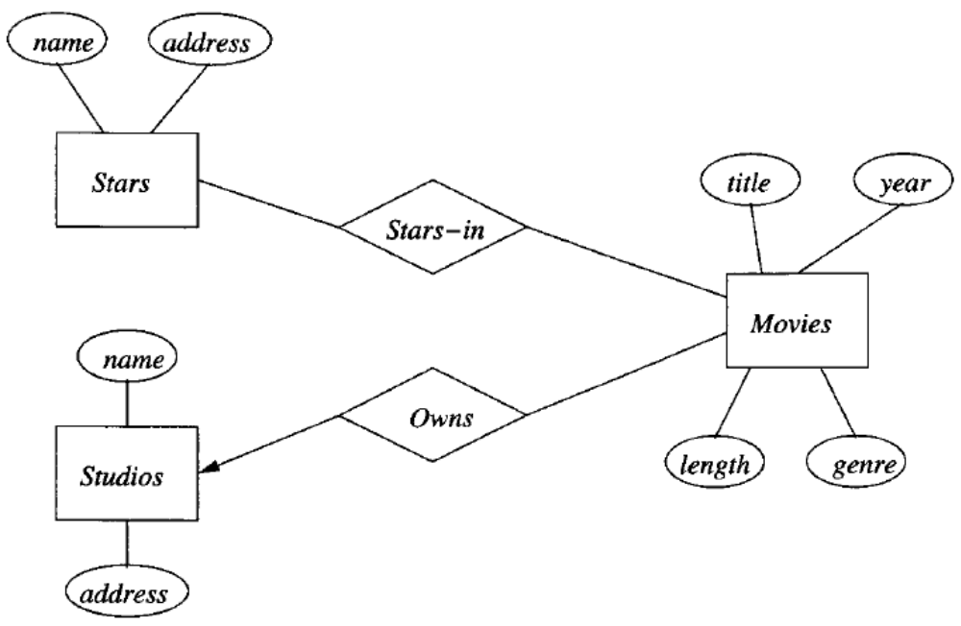
4.1.4 Entity-Relationship Diagrams
How to represent Relationships
  Relationship are represented by diamonds
  Edges connect a relationship to its entity sets
  Need to node the type of relationship

Slide 25
4.1.4 Entity-Relationship Diagrams
Types of relationship
Universities
Runs
Presidents
One - one relationship
Students
Has
Departments
One - many relationship
Students
Studies
Courses
Many - many
relationship
There are different notation styles for representing relationships: Chen, IDEFlX, Crow’s Foot, Min-max

Slide 26
4.1.4.Entity-Relationship Diagrams
How to represent the attribute of a relationship?
Sometimes it is useful to attach an attribute to a relationship.
Think of this attribute as a property of tuples in the relationship set.
Star-In
Movies
Stars
salary

Slide 27
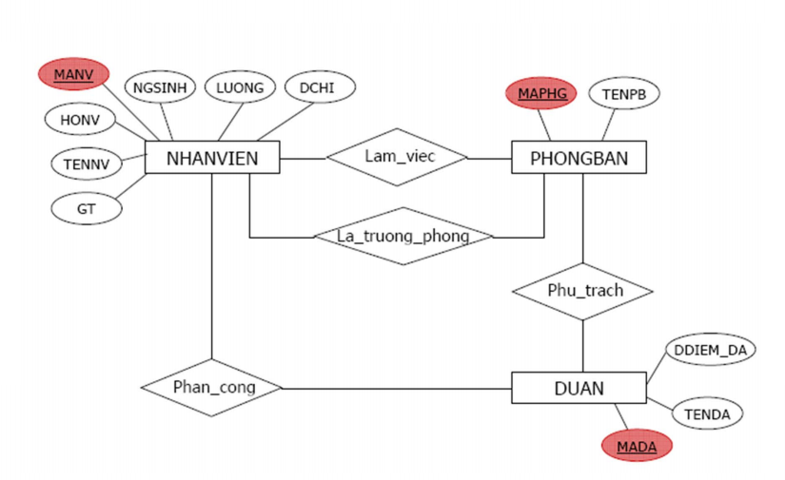
Example

Slide 28
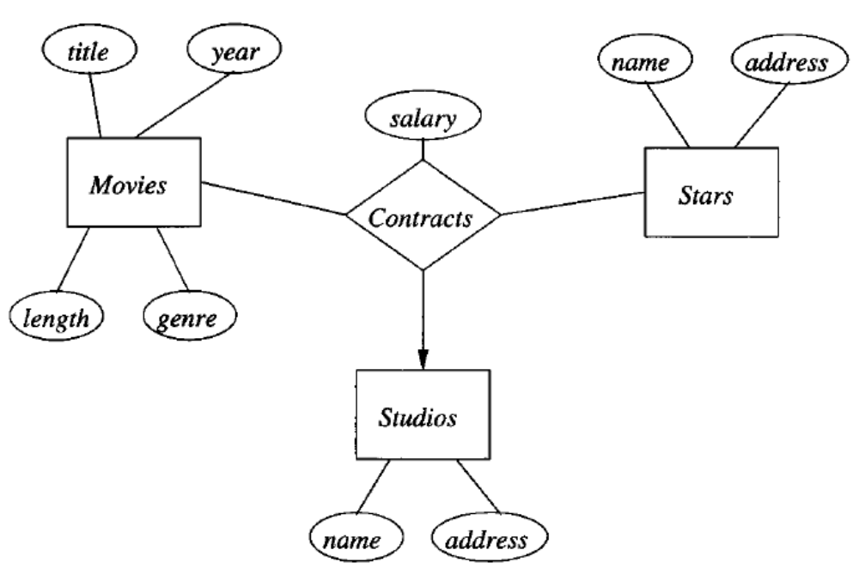
4.1.5. Multiway relationships
Multiway relationships:
  Relationships involving more than 2 entity sets

Slide 29
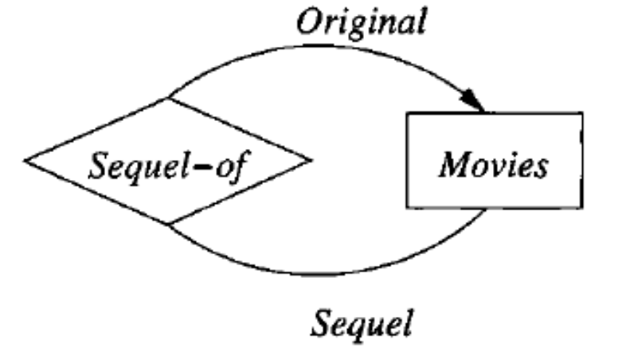
4.1.6 Roles in relationships
It is possible that one entity set appears two or more times in a single relationship
Draw as many lines from the relationship to the entity set as the entity set appears in the relationship
Each line represents a different role that the entity set plays in the relationship

Slide 30

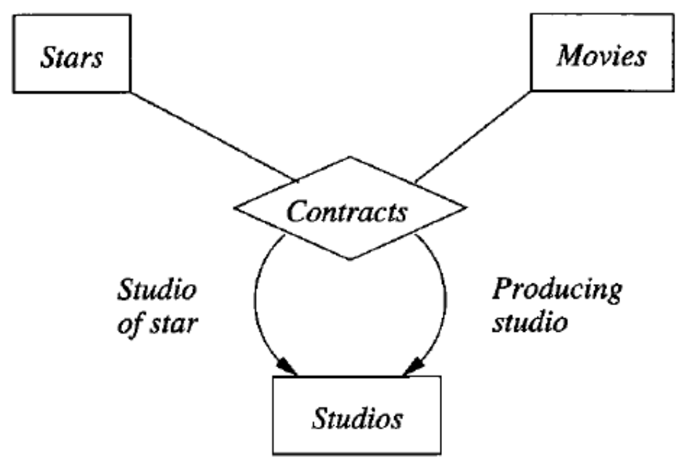
Example

Slide 31
4.1.7. Weak Entity Set
A Weak Entity is an entity that cannot be uniquely identified by its attributes alone; therefore, it must use a foreign key in conjunction with its attributes to create a primary key
In ERD, a weak entity set is indicated by a Double-Rectangle (the entity), and Double-Diamond indicates a many-one relationship that helps provide the key for the weak entity set.
name
number
name
address
Players
Plays-
on
Teams
Note: must be rounded
because each player needs
a team to help with the key.

Slide 32
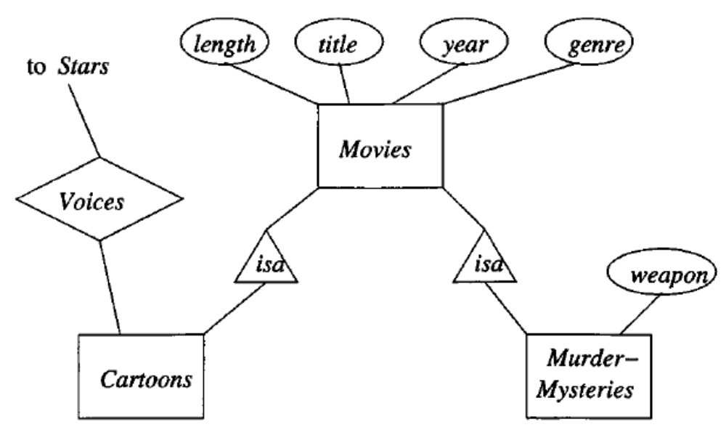
4.1.8 SUB-CLASSES in ER Model
An entity set may contain entities that have special properties not associated with all members of the set
  Group these entities in a Subclasse entity set
Connect an entity set to its subclasses using a relationship called “isa”.
Subclasses have its special attributes and/or relationships

Slide 33
Summary
Database design process has three phase: conceptual, logical and physical design.
E/R model has used in conceptual design phase to capture requirements of applications.
Main concepts in E/R model are: entity, entity instances, entity set, attribute, relationship (many-many, one-many, one-one, mandatory, optional)
Others concepts are: weak entity, multi-way relationship, sub-class

Slide 34
Cty có nhiều đơn vị, mỗi đơn vị (phòng ban) có tên duy nhất, mã đơn vị duy nhất, một trưởng phòng và ngày nhậm chức.
Mỗi đơn vị có thể ở nhiều địa điểm khác nhau. Dự án có tên duy nhất, mã duy nhất, do 1 một phòng ban chủ trì và được triển khai ở 1 địa điểm.  Nhân viên có mã số, tên, địa chỉ, ngày sinh, giới tính và lương. Mỗi nhân viên làm việc ở 1 phòng ban, tham gia vào các đề án với s ố giờ làm việc khác nhau. Mỗi nhân viên đều có một người quản lý trực tiếp.  Một nhân viên có thể có những người con được hưởng bảo hiểm theo nhân viên. Mỗi người con của nhân viên có tên, giới tính, ngày sinh.

Slide 35
Thank You !

